Slide 1
Pixels, Image Representations, Sampling, and Quantization
GC University Faisalabad
Course Title: Digital Image Processing Lecture Topic: Pixels, Image Representations, Sampling, and Quantization Instructor: Adnan Majeed Semester: 5th | Credit Hours: 3(2–1)

Slide 2
Lecture Objectives
By the end of this lecture, students should be able to:
Understand what pixels are and how they represent image data.
Describe digital image representation in spatial and intensity domains.
Explain the processes of sampling and quantization.
Analyze how resolution and quantization affect image quality.

Slide 3
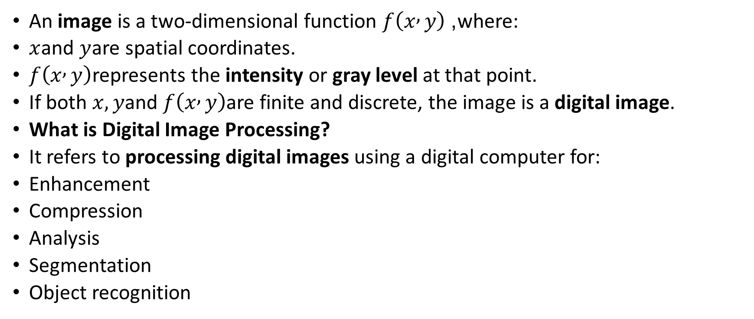
Introduction to Digital Images What is an Image?
An image is a two-dimensional function $f\left(x , y\right)$, where:
$x$and $y$are spatial coordinates.
$f\left(x , y\right)$represents the intensity or gray level at that point.
If both $x,y$and $f\left(x , y\right)$are finite and discrete, the image is a digital image.
What is Digital Image Processing?
It refers to processing digital images using a digital computer for:
Enhancement
Compression
Analysis
Segmentation
Object recognition

Slide 4
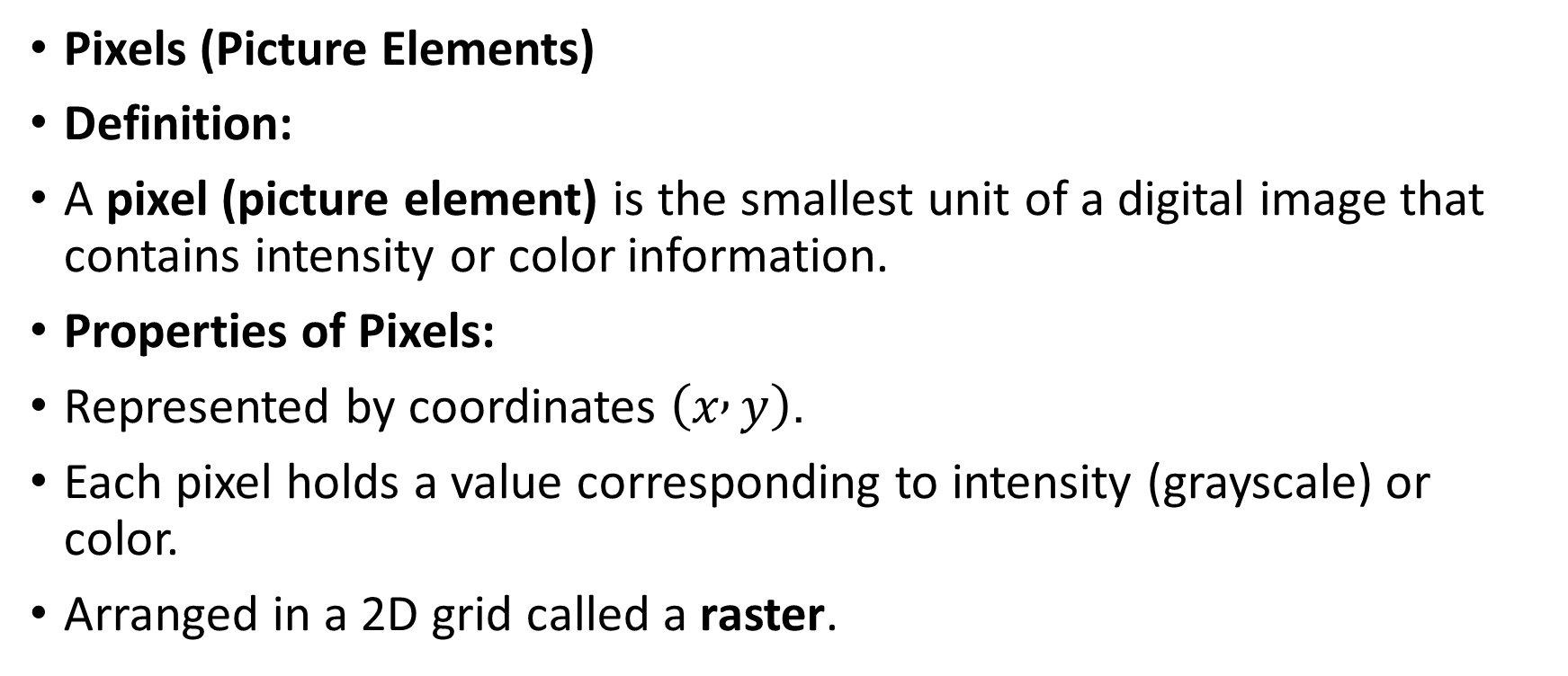
Pixels (Picture Elements)
Definition:
A pixel (picture element) is the smallest unit of a digital image that contains intensity or color information.
Properties of Pixels:
Represented by coordinates $\left(x , y\right)$.
Each pixel holds a value corresponding to intensity (grayscale) or color.
Arranged in a 2D grid called a raster.

Slide 5
Example
Pixel Coordinate | Intensity (0–255)
(0,0) | 125
(0,1) | 128
(1,0) | 130
(1,1) | 255

Slide 6

Bit Depth:
Number of bits used to represent pixel intensity.
Determines number of gray levels:
$L=2^{k}$
where $k$= bits per pixel.

Slide 7
Bit Depth | Gray Levels | Example
1-bit | 2 | Black and White
8-bit | 256 | Grayscale
24-bit | 16.7 million | True Color

Slide 8
Image Representations (a) Spatial Domain Representation
Image is represented by pixels arranged in a grid.
Operations are applied directly on pixel values.
Example: Image enhancement, contrast adjustment.
(b) Intensity (Gray Level) Representation
Intensity values represent brightness.
Grayscale images: range from 0 (black) to 255 (white).
(c) Color Image Representation
Represented by combining three primary colors (RGB).
Each color component has an 8-bit intensity value.
Red (0–255)
Green (0–255)
Blue (0–255)
A pixel color = (R, G, B)

Slide 9
(d) Binary Image Representation
Pixels are represented by 0 (black) and 1 (white).
Used for document images or edge detection results.

Slide 10
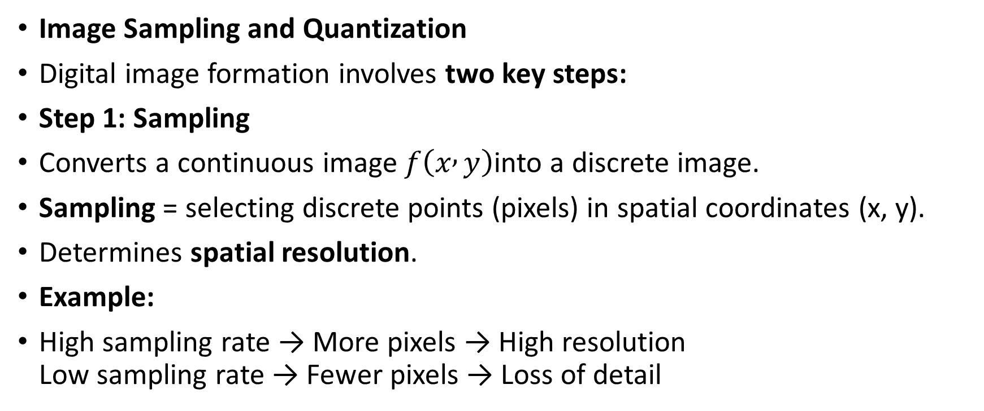
Image Sampling and Quantization
Digital image formation involves two key steps:
Step 1: Sampling
Converts a continuous image $f\left(x , y\right)$into a discrete image.
Sampling = selecting discrete points (pixels) in spatial coordinates (x, y).
Determines spatial resolution.
Example:
High sampling rate → More pixels → High resolution Low sampling rate → Fewer pixels → Loss of detail

Slide 11
Step 2: Quantization
Converts continuous intensity values into discrete levels.
Determines intensity resolution (number of gray levels).

Slide 12
Quantization Levels | Image Quality
2 levels (1-bit) | Poor
16 levels (4-bit) | Acceptable
256 levels (8-bit) | Good

Slide 13
Sampling vs Quantization
Aspect | Sampling | Quantization
Domain | Spatial | Intensity
Purpose | Select pixel locations | Assign discrete intensity values
Affects | Spatial Resolution | Gray Level Resolution
Unit | Pixels per inch (PPI) | Bits per pixel (bpp)

Slide 14
Effects of Sampling & Quantization
Operation | Effect
Low Sampling | Blurred or blocky image
High Sampling | Sharp image, larger file
Low Quantization | Posterization effect (banding)
High Quantization | Smooth grayscale transitions

Slide 15

Mathematical Representation
If a digital image has:
$M$rows and $N$columns
$L$gray levels

Slide 16
Practical Example in Python (Optional Lab Activity)
import cv2
import matplotlib.pyplot as plt
# Load image in grayscale
image = cv2.imread('image.jpg', 0)
# Sampling: Resize image
sampled = cv2.resize(image, (64, 64))
# Quantization: Reduce gray levels to 16
quantized = (image // 16) * 16
# Display results
plt.figure(figsize=(12,4))
plt.subplot(131); plt.imshow(image, cmap='gray'); plt.title("Original")
plt.subplot(132); plt.imshow(sampled, cmap='gray'); plt.title("Sampled (64x64)")
plt.subplot(133); plt.imshow(quantized, cmap='gray'); plt.title("Quantized (16 Levels)")
plt.show()

Slide 17
Summary
Concept | Description
Pixel | Smallest image unit
Image Representation | How image data is stored (spatial/intensity/color)
Sampling | Discretization of spatial coordinates
Quantization | Discretization of intensity values
Resolution | Depends on sampling and quantization levels

Slide 18
Review Questions
Define a digital image and pixel.
What is the difference between sampling and quantization?
Explain bit depth and its effect on image quality.
Describe spatial and intensity domain representations.
How do sampling rate and quantization levels affect image resolution?

Slide 19
Recommended Readings
Rafael C. Gonzalez & Richard E. Woods, Digital Image Processing, 4th Edition, Pearson.
Anil K. Jain, Fundamentals of Digital Image Processing, Prentice-Hall.
Lecture slides and lab manuals provided by GCUF Department of Computer Science.

